Slide 1

Useful RDKit Utils A Motley Collection of Helpful Routines
Pat Walters | RDKit US UGM | April 10, 2025

Slide 2
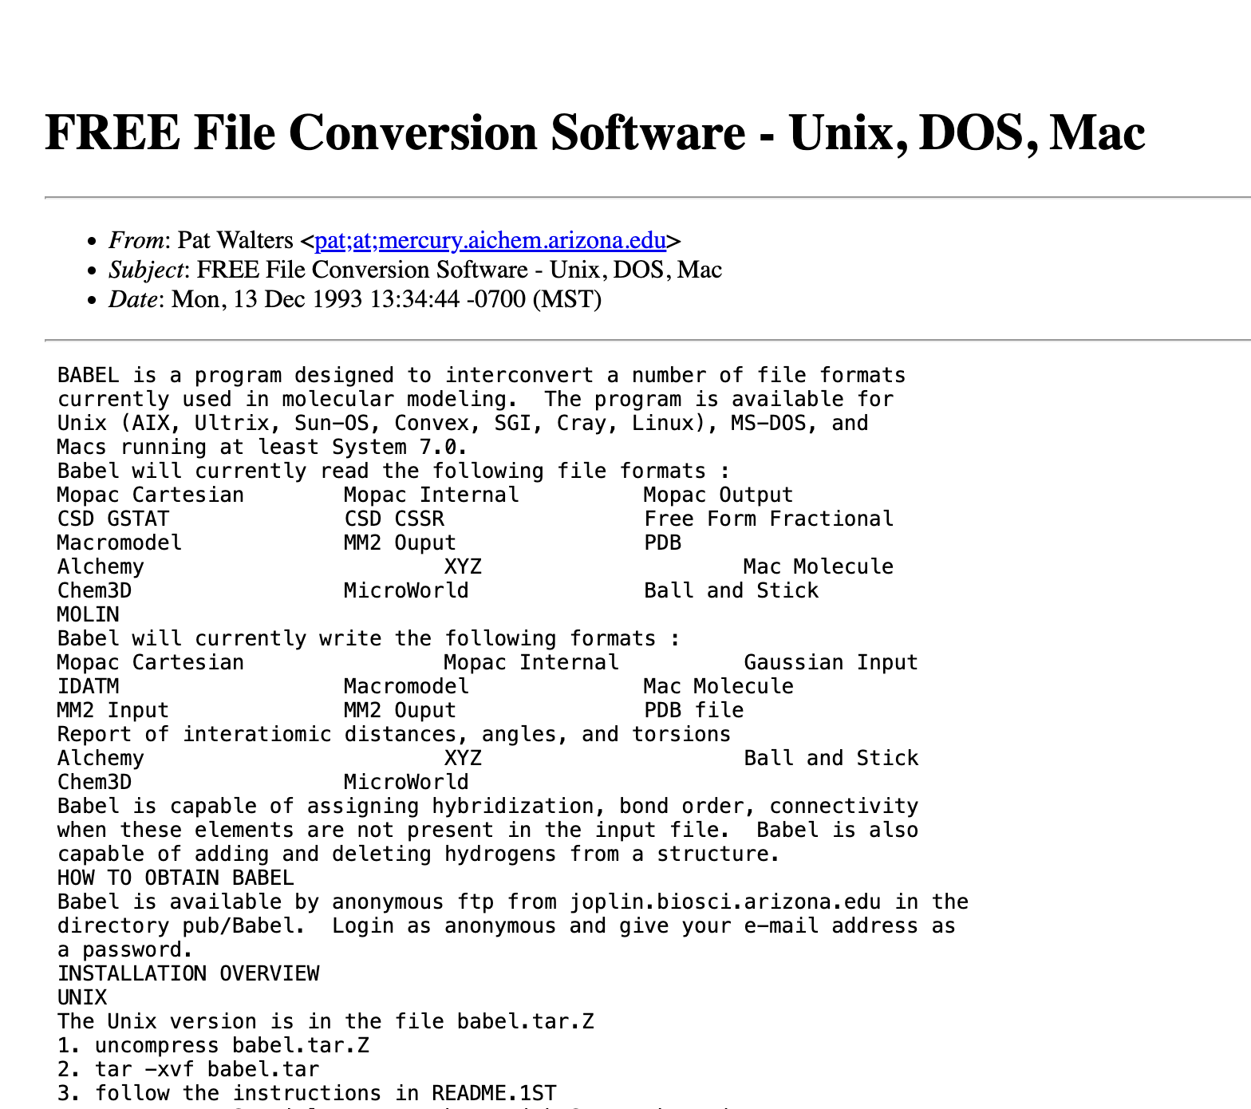
My History With Open Source Cheminformatics
Open Babel
Babel
OBabel
OELib
OEChem

Slide 3
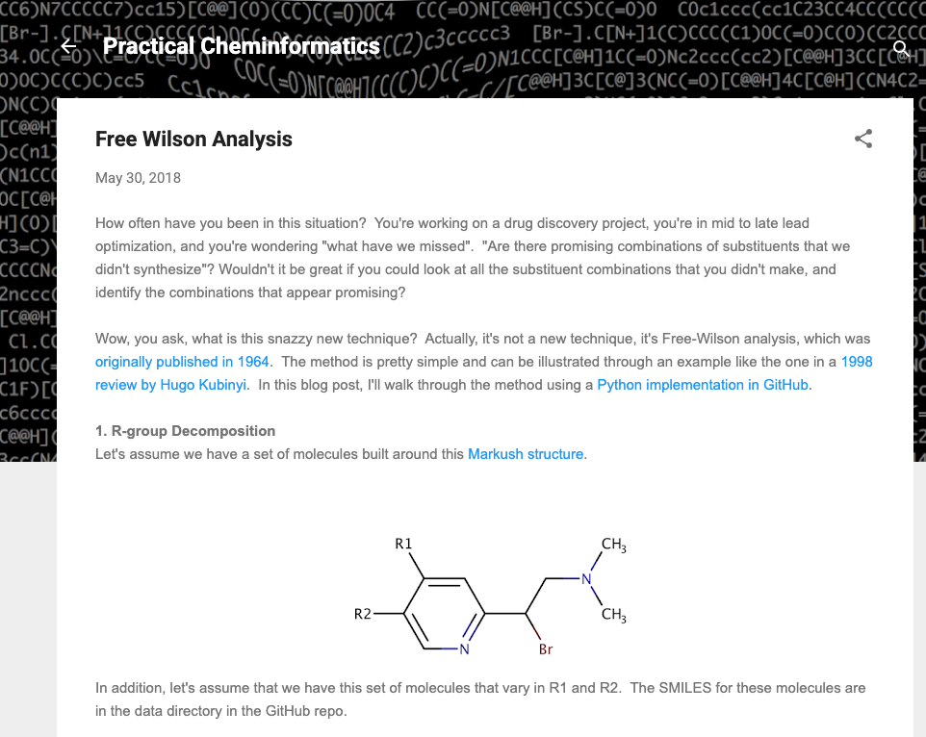
Practical Cheminformatics – Founded 2018

Slide 4
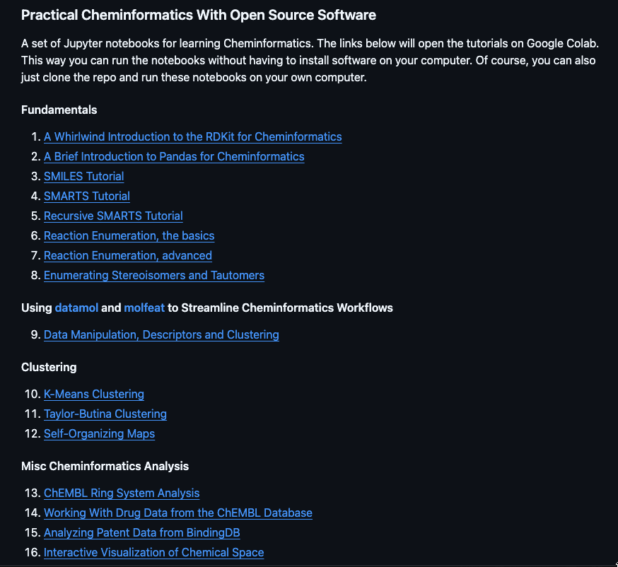
Practical Cheminformatics Tutorials – Founded 2019

Slide 5
Current Practical Cheminformatics Tutorial Content
Fundamentals
RDKit Basics
SMILES
SMARTS
Reactions
Clustering
SAR Analysis
Scaffold
R-group Analysis
Free-Wilson
MMP and MMS
Databases
Ring Systems
ChEMBL
BindingDB
Machine Learning
Model Building
Model Comparison
Active Learning
Neural Network Potentials
Generative Models
Bayesian Reaction Optimization
33 tutorials are currently available

Slide 6
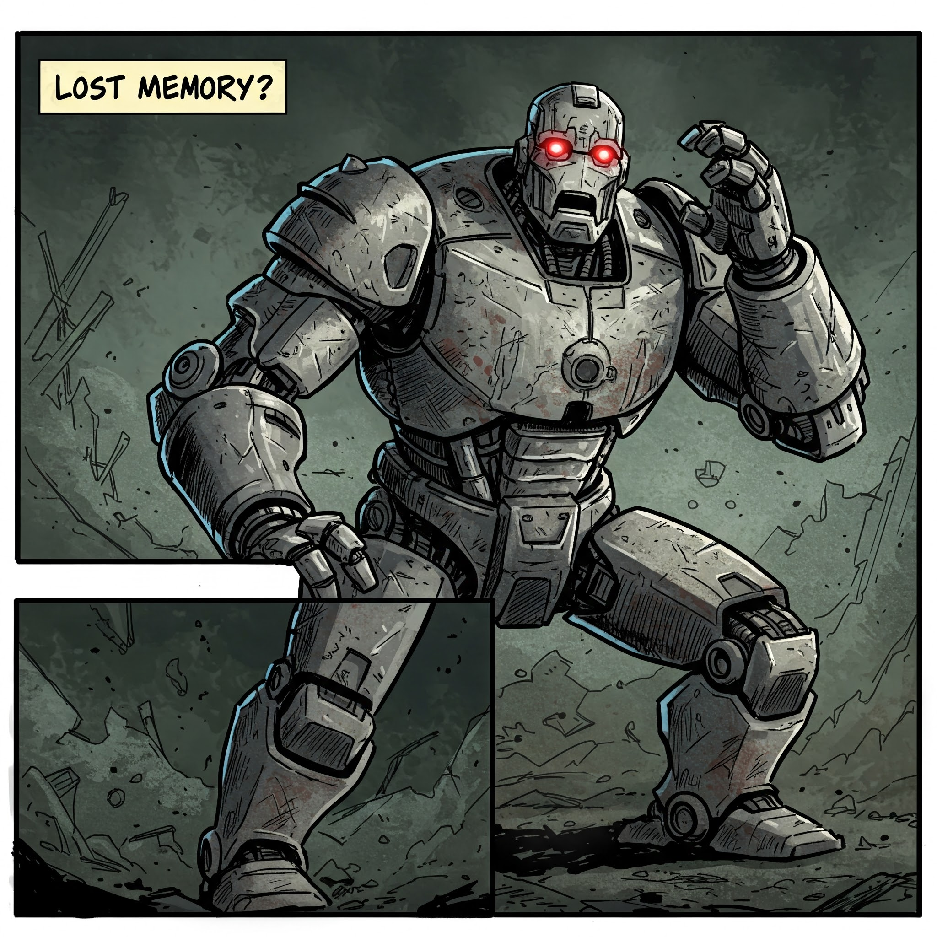
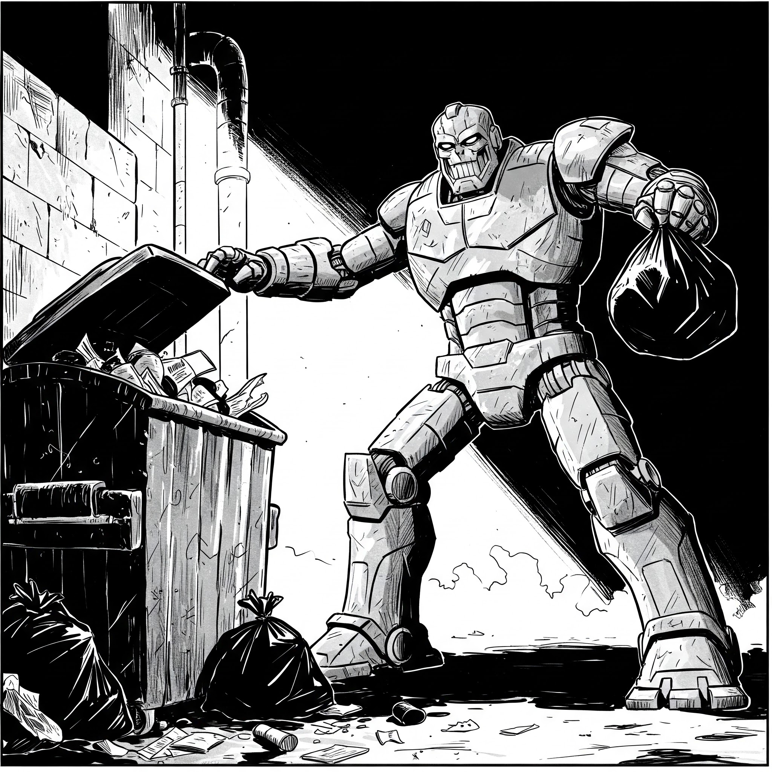
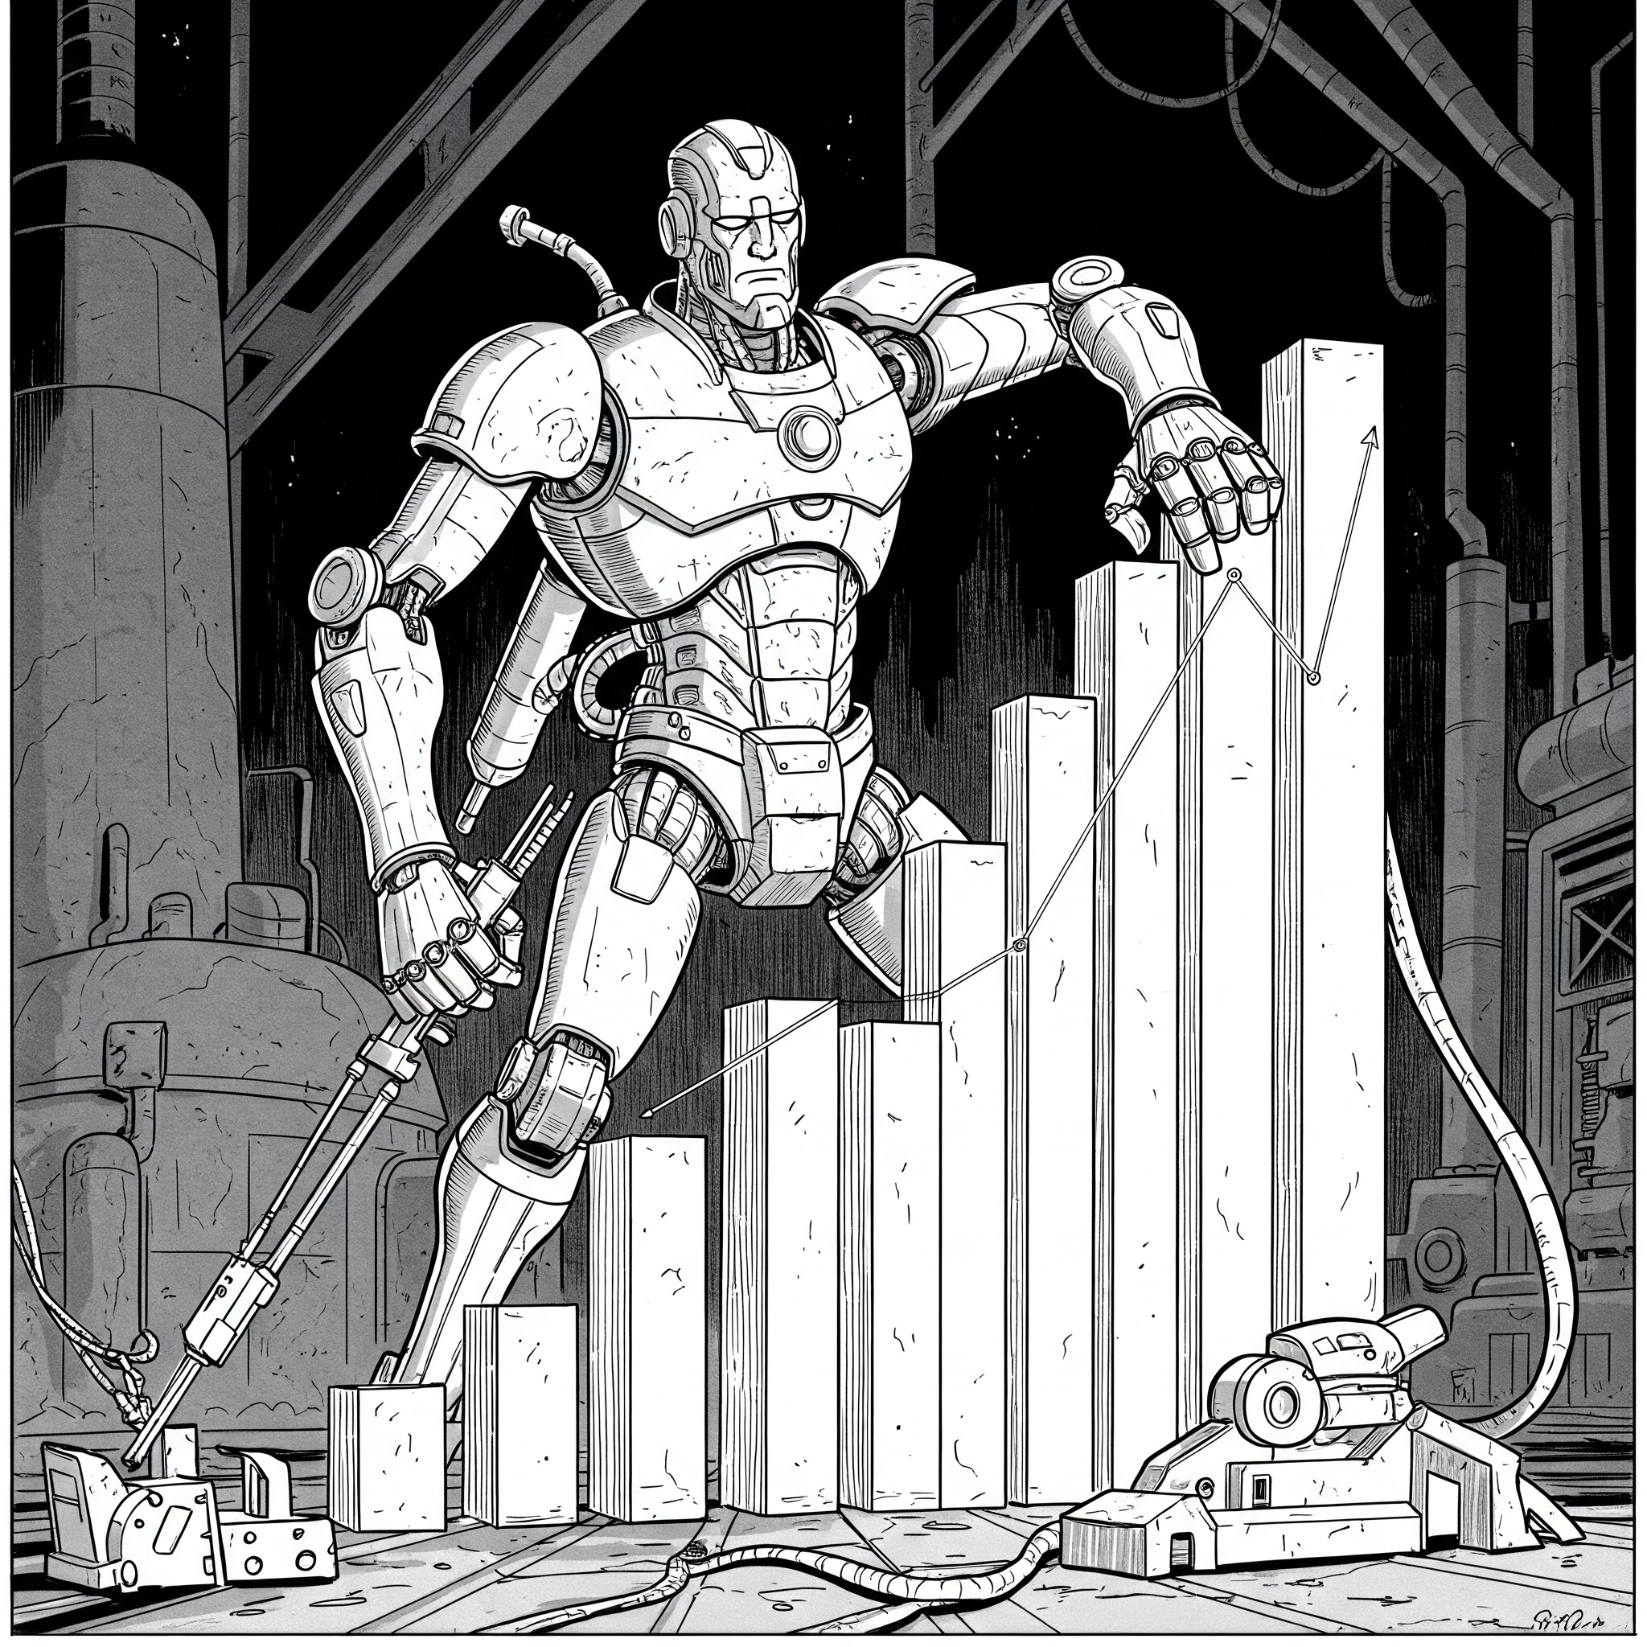


Overview
Things I Frequently Forget How To Do
Taking Out the Trash
Plots
Put a Ring On It
Evaluating Models the Right Way

Slide 7
Things I Frequently Forget How to Do

Slide 8
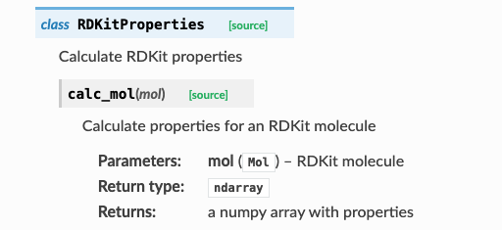
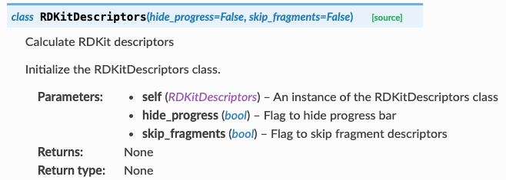
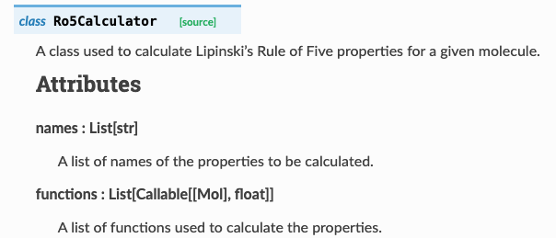
Useful Calculators
Operate on SMILES or molecules
Can return a Pandas dataframe

Slide 9
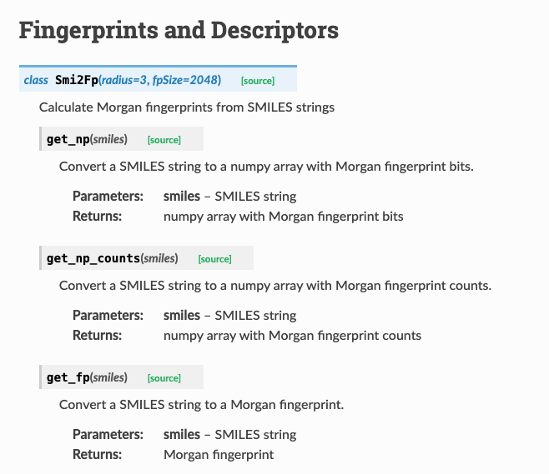
Generating Fingerprints From SMILES

Slide 10
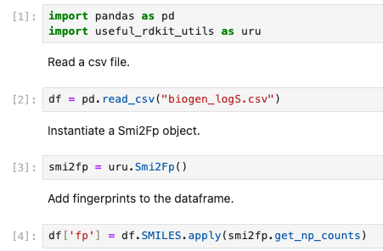
Smi2Fp Example

Slide 11
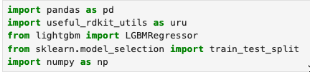
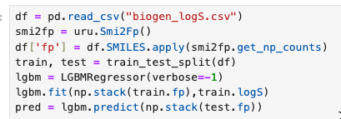
A Machine Learning Model in 7 Lines of Code
Read the data

Slide 12
A Machine Learning Model in 7 Lines of Code
Create a Smi2Fp object

Slide 13
A Machine Learning Model in 7 Lines of Code
Generate fingerprints

Slide 14
A Machine Learning Model in 7 Lines of Code
Split into training and test sets

Slide 15
A Machine Learning Model in 7 Lines of Code
Create the regressor

Slide 16
A Machine Learning Model in 7 Lines of Code
Train the model

Slide 17
A Machine Learning Model in 7 Lines of Code
Make predictions

Slide 18
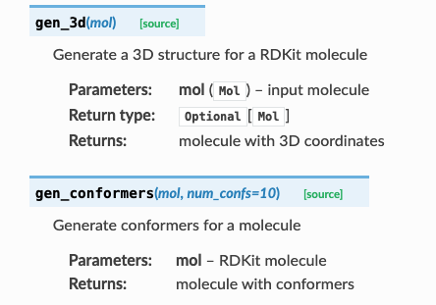
Generating 3D Structures and Conformers

Slide 19
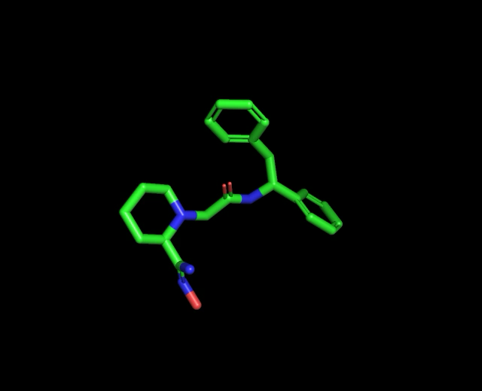
How Well Are Analogs Docked?

Slide 20
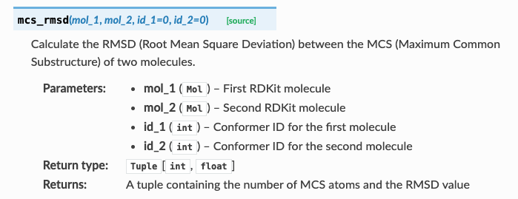
How Well Are Analogs Docked?

Slide 21
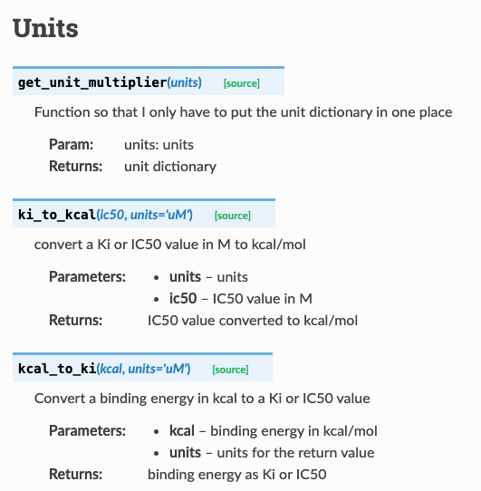
Converting Units for Free Energy Calculations

Slide 22
Throwing Out the Trash

Slide 23
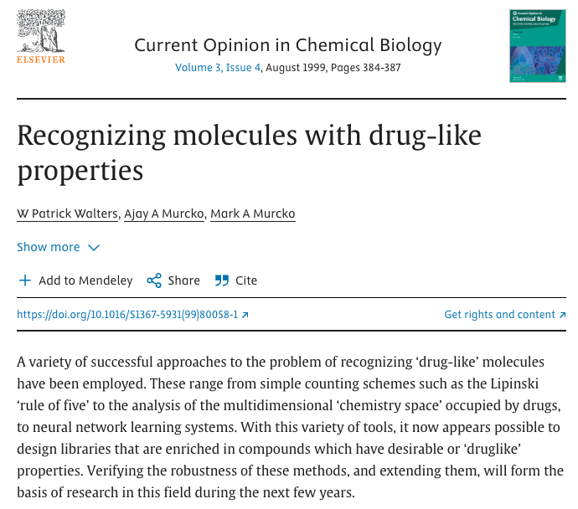
REOS – Rapid Elimination of Swill

Slide 24
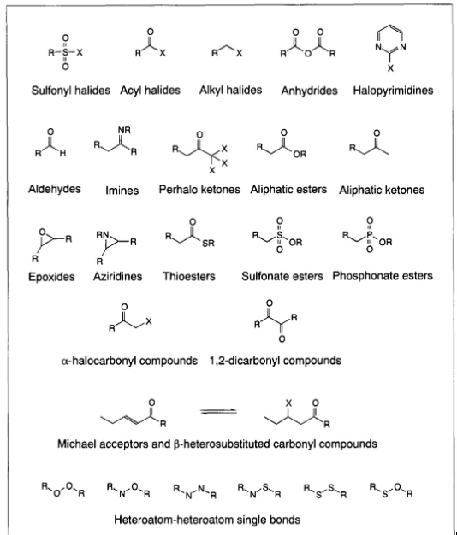
Functional Group Filters Have a Long History
Rishton, Gilbert M. "Reactive compounds and in vitro false positives in HTS." Drug Discovery Today 2.9 (1997): 382-384.

Slide 25
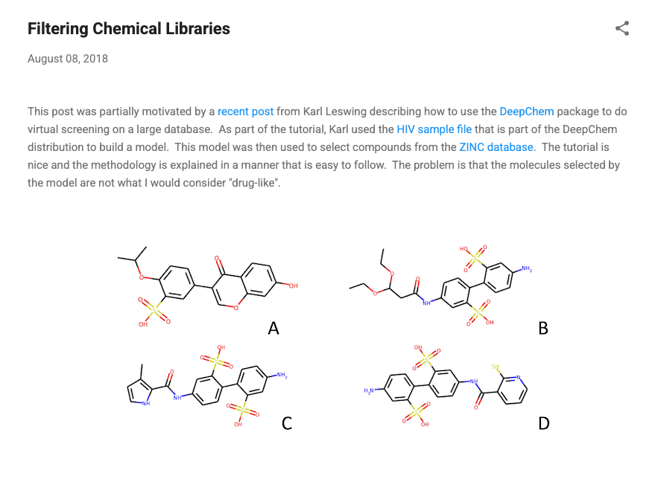
Practical Cheminformatics – August 8, 2018

Slide 26
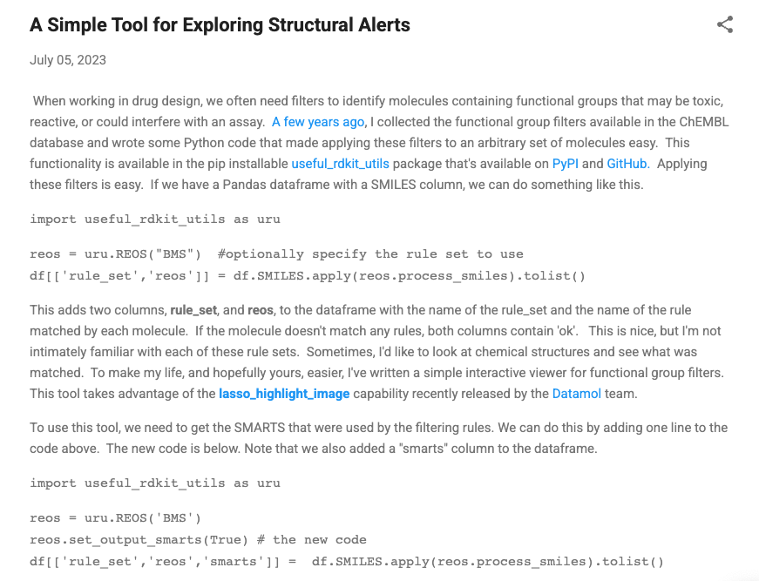
Practical Cheminformatics - July 5, 2023

Slide 27
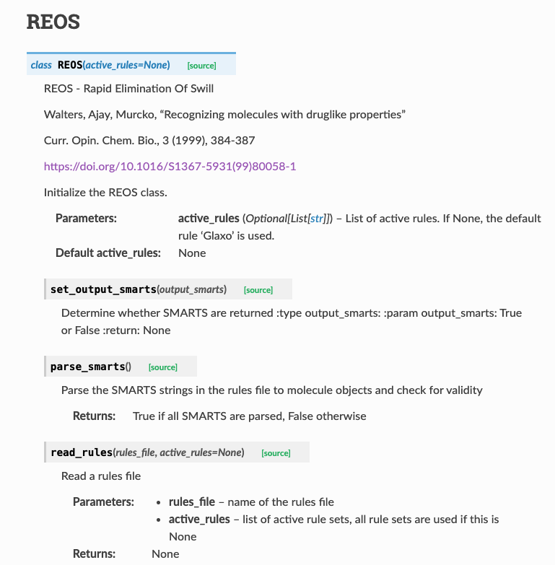
The REOS Class

Slide 28
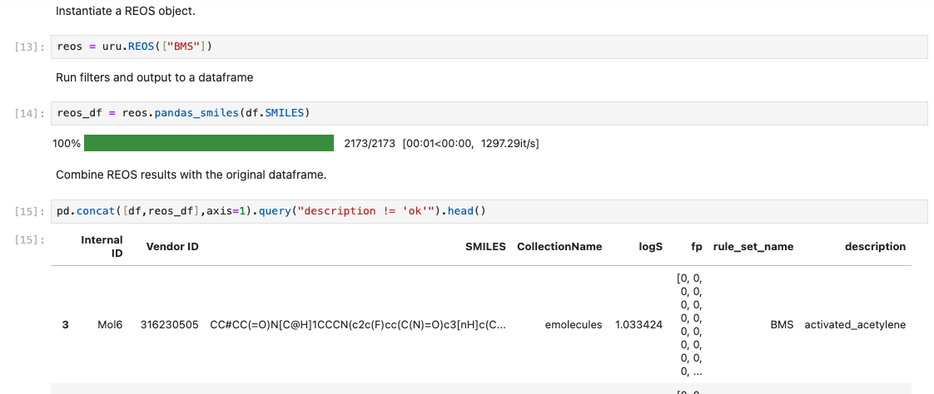
REOS Example

Slide 29
Plots

Slide 30
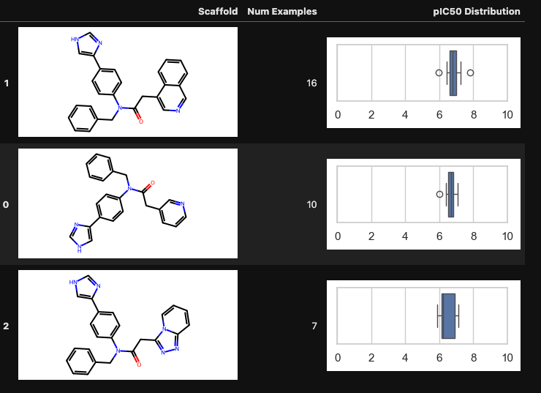
Plotting Activity Distributions For Scaffolds
Boxplots as Base64
Structure Images as Base64
Images added to a Pandas dataframe and viewed as HTML

Slide 31
Put a Ring On It

Slide 32
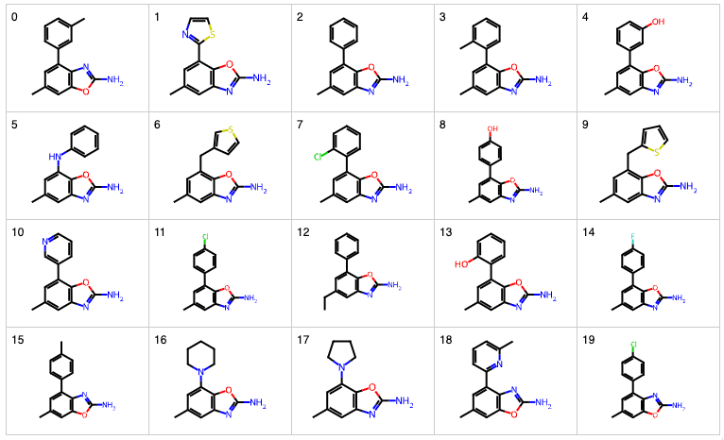
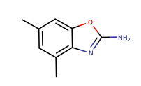
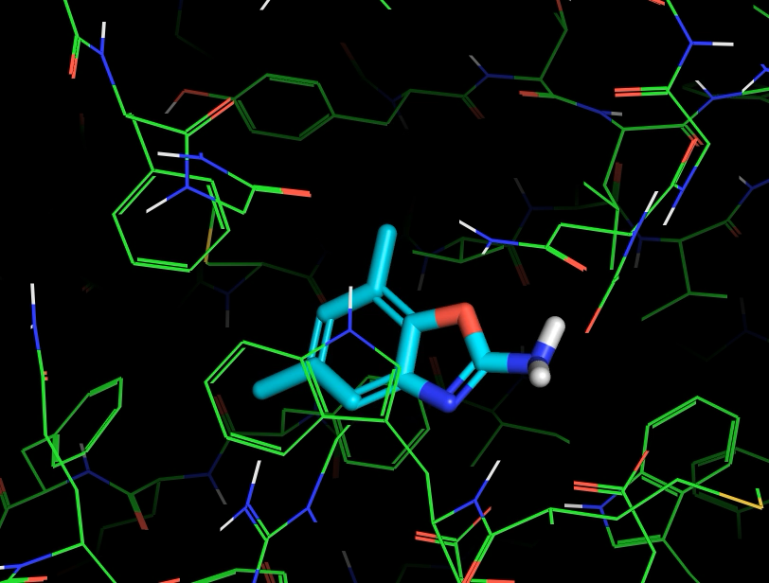
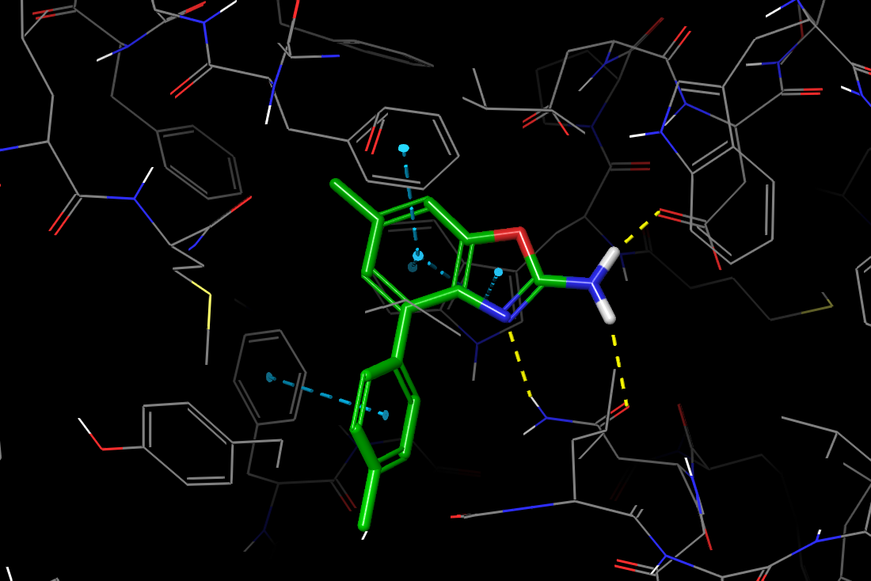
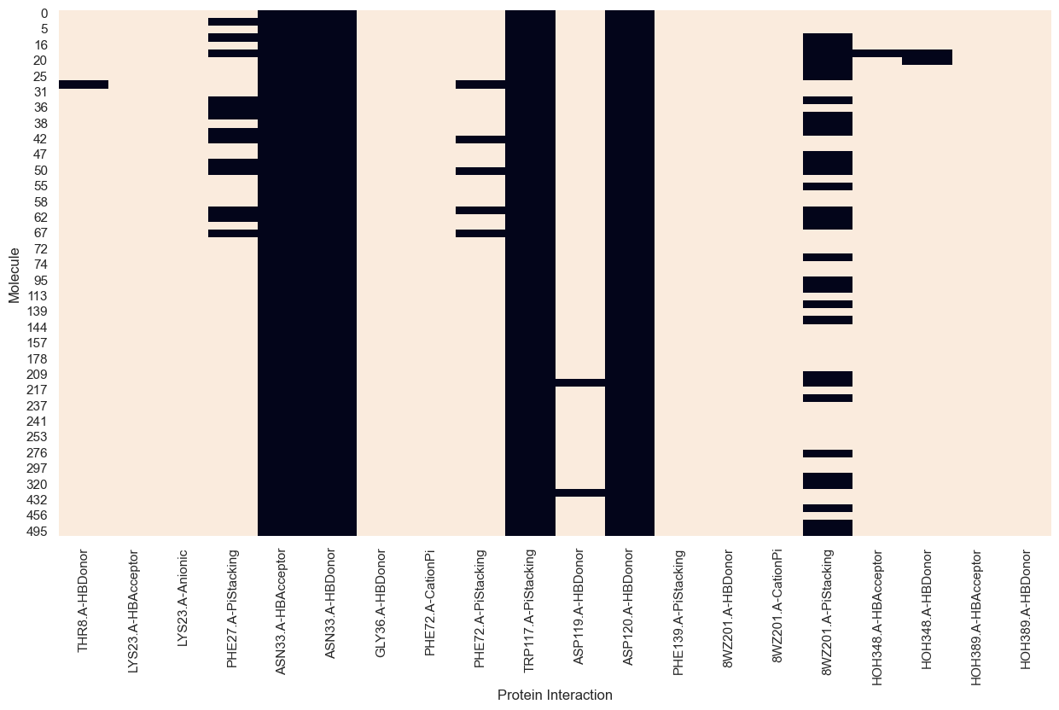
A Generative Design Workflow for Fragment Screening
Fragment hit
Generate analogs
Dock
Visualize
Cluster interaction fingerprints

Slide 33
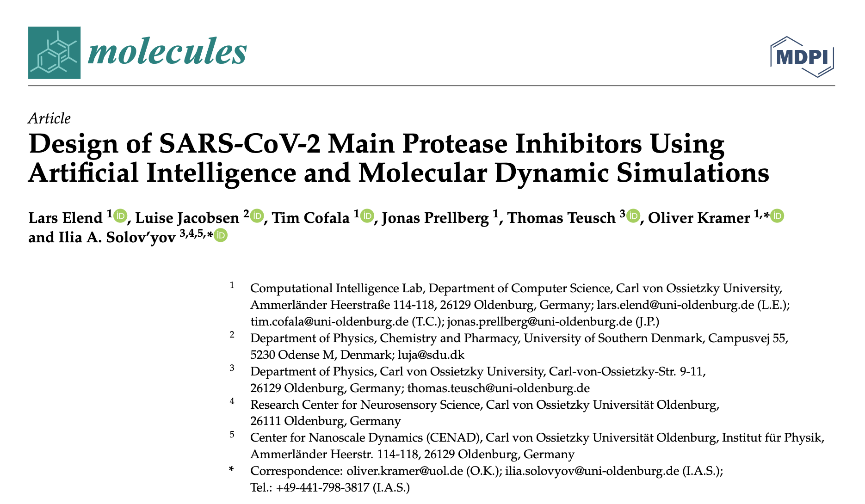
Molecule Generation is Not Without Its Problems
Molecules 2022, 27, 4020

Slide 34
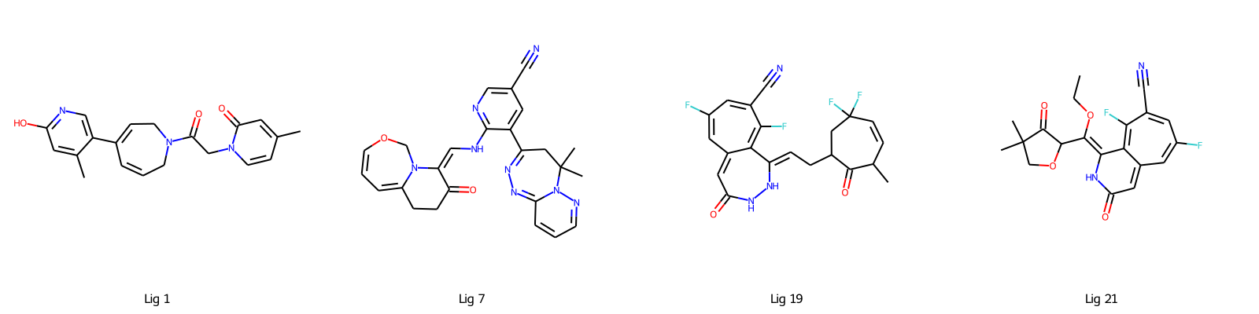
Highest Scoring Molecules Contain Questionable Functionality

Slide 35






Highest Scoring Molecules Contain Questionable Functionality

Slide 36
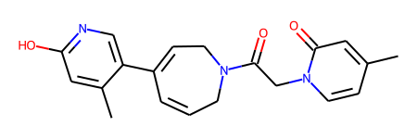
Evaluating Ring System Frequency
Ring
Occurrences in ChEMBL
225,475
0
11,363
✅
❌
✅

Slide 37
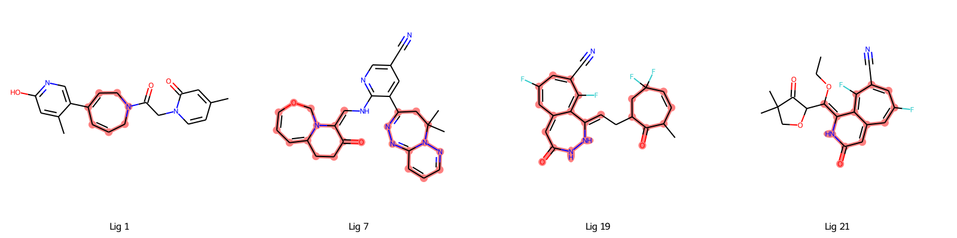
Top Molecules

Slide 38
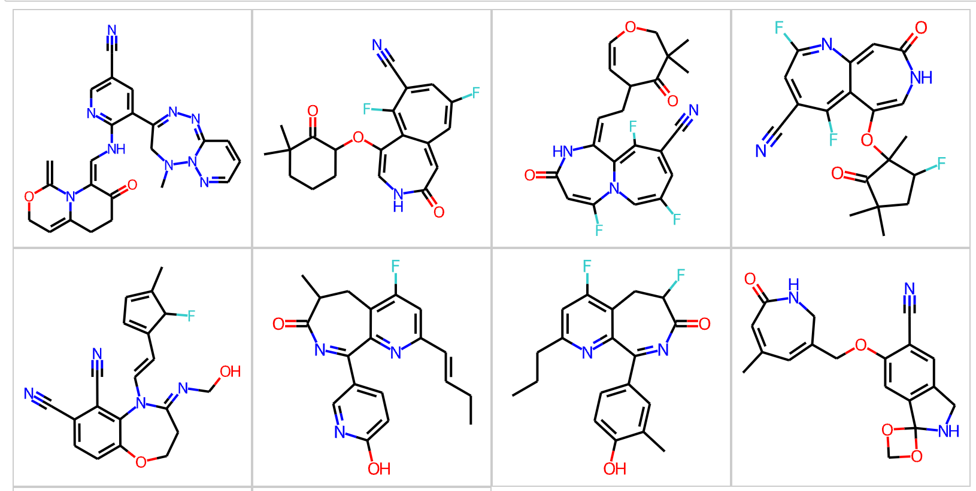
Evaluating Generative Model Output
144,350 molecules generated
23 molecules violated rules of valence
107,386 (74%) contained ring systems not found in ChEMBL
144,350 (79%) contained ring systems occurring < 10 times in ChEMBL
Molecules 2022, 27, 4020

Slide 39
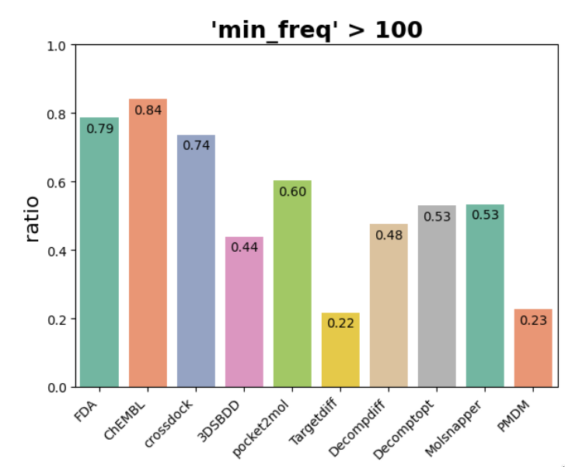
Plausibility Problems Persist
Preprint from Dec 2024
Yang, Bo, Chijian Xiang, and Jianing Li. "3D Structure-based Generative Small Molecule Drug Design: Are We There Yet?." bioRxiv (2024): 2024-12.

Slide 40
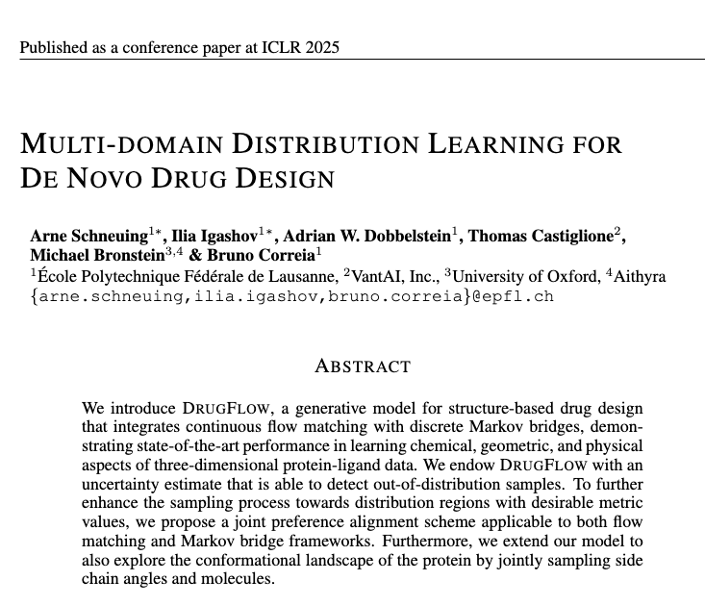
DrugFlow – Published January 22, 2025

Slide 41
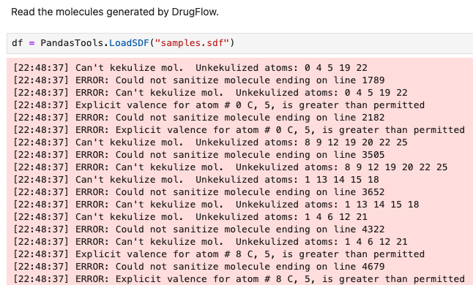
DrugFlow – 13 of 128 Molecules Violated Rules of Valence

Slide 42
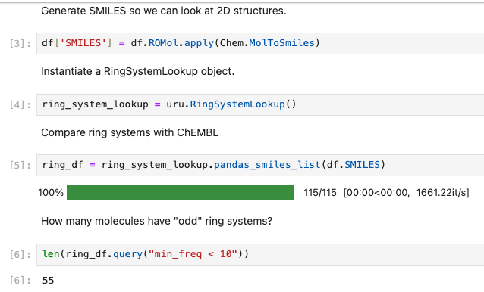
Using RingSystemLookup With DrugFlow Generated Molecules

Slide 43
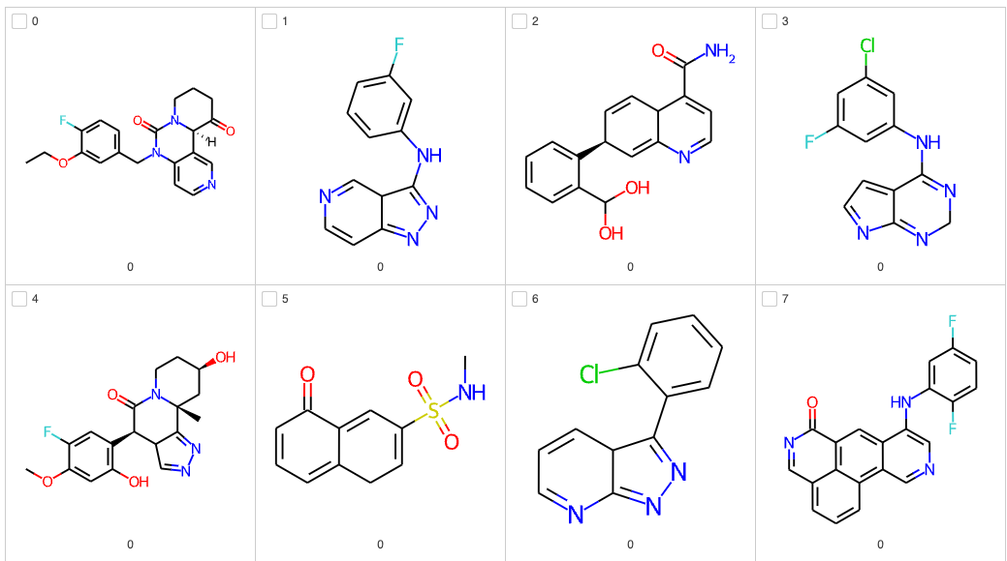
Some of the Rejected DrugFlow Molecules
# of times the ring system appears in ChEMBL

Slide 44
Evaluating Models the Right Way

Slide 45

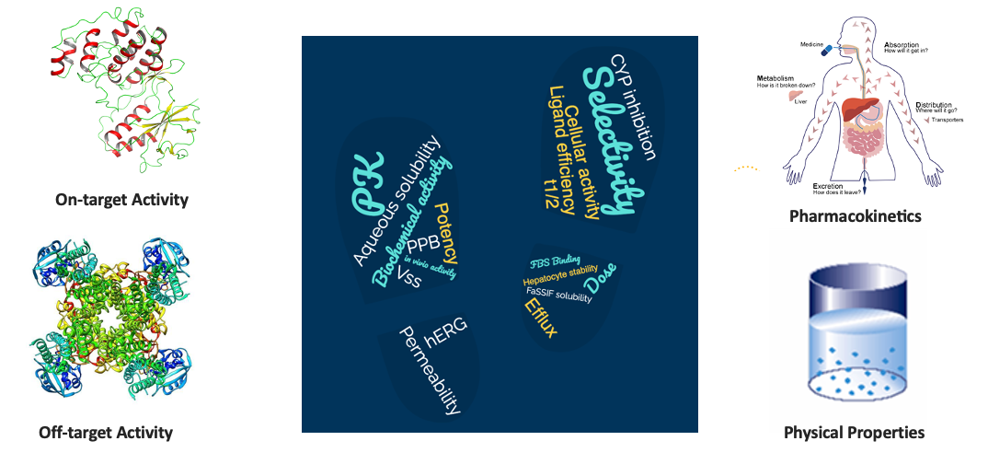
Validation Requires Good Datasets and Solid Statistics
Datasets
Statistical Comparisons

Slide 46

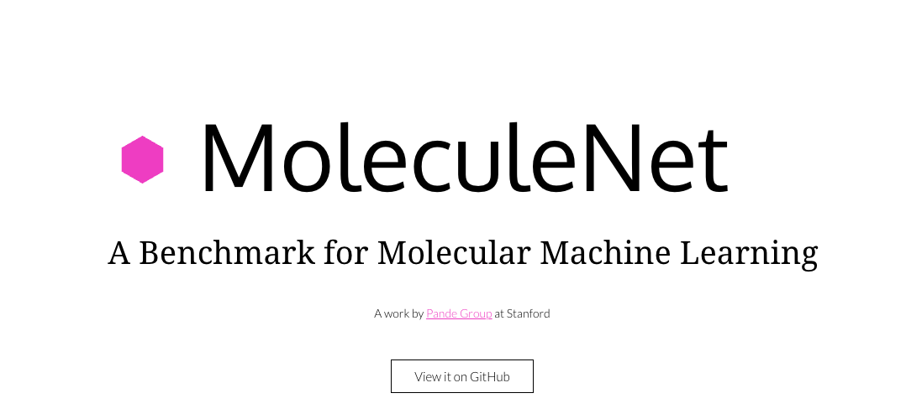
Don’t Use Flawed Benchmarks to Validate Your Methods

Slide 47
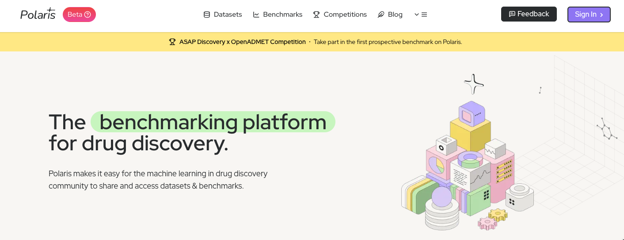
https://polarishub.io

Slide 48
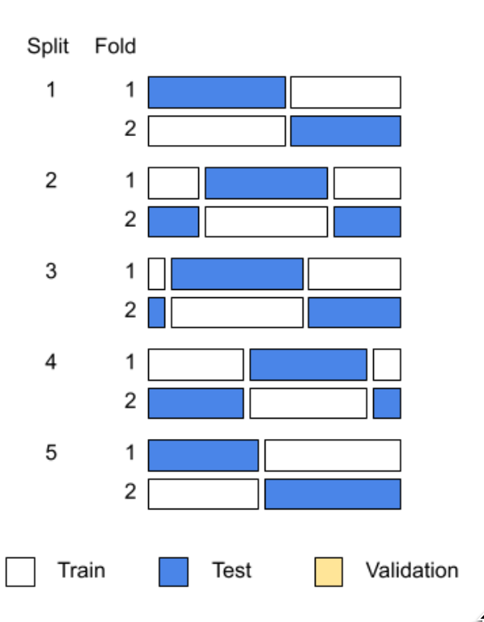
Comparing Mean Performance Across Cross-Validation Folds
Method | Mean R²
1 | 0.46
2 | 0.48

Slide 49
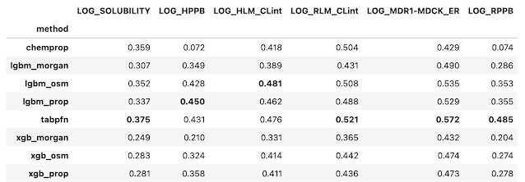
The Dreaded “Bold Table”

Slide 50
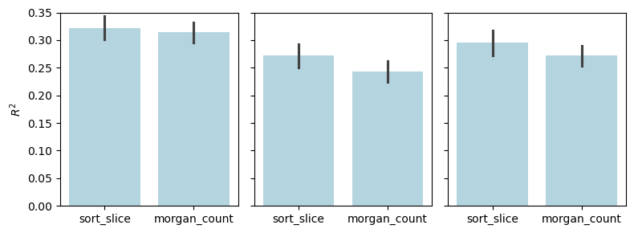

Barplots Are Inadequate For Method Comparisons

Slide 51
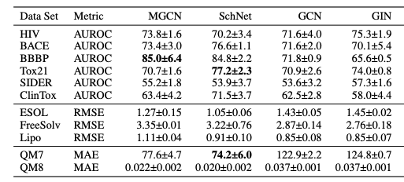
The Dreaded “Bold Table” + Standard Deviation
The standard deviation is a measure of variance
It is not a statistical test

Slide 52
Adding Error Bars Doesn’t Help

Slide 53
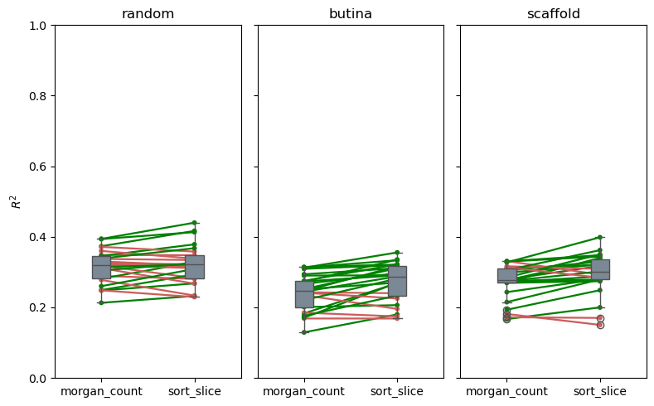
Correlations Differ Across Cross-Validation Folds

Slide 54
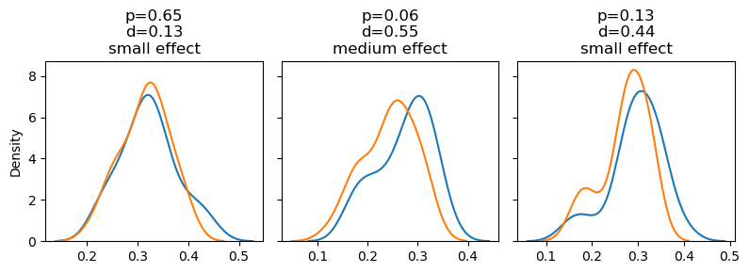
We Have Distributions Across Folds
There are well established statistical tests for comparing distributions
R²

Slide 55
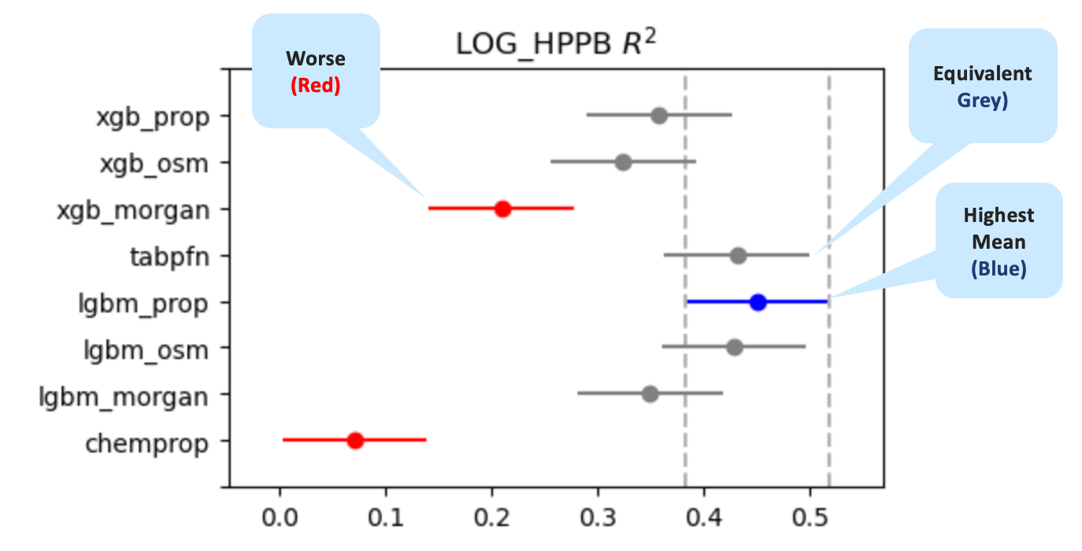
Model Comparison Using StatsModels

Slide 56
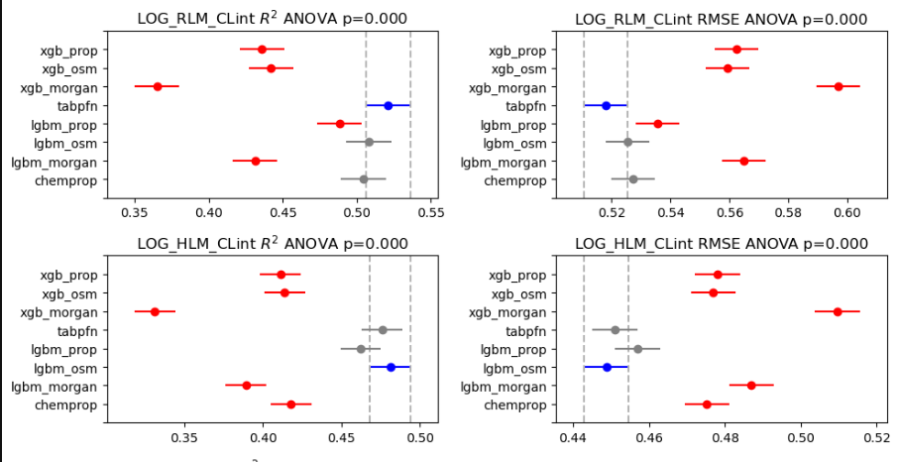
Comparing Multiple Methods

Slide 57

Validate a Model With a Few Lines of Code
Read the data from Polaris

Slide 58
Validate a Model With a Few Lines of Code
Get the data as a Pandas dataframe

Slide 59
Validate a Model With a Few Lines of Code
“SMILES” should always be in all caps

Slide 60
Validate a Model With a Few Lines of Code
Get the names of the assay columns

Slide 61
Validate a Model With a Few Lines of Code
For each assay column

Slide 62
Validate a Model With a Few Lines of Code
Handle incomplete data matrix

Slide 63
Validate a Model With a Few Lines of Code
List of models to be compared

Slide 64
Validate a Model With a Few Lines of Code
List of splitting methods to be used

Slide 65
Validate a Model With a Few Lines of Code
Perform 5x5 cross-validation

Slide 66
Validate a Model With a Few Lines of Code
Write the results

Slide 67
Overview
Things I Frequently Forget How To Do
Taking Out the Trash
Plots
Put a Ring On It
Evaluating Models the Right Way

Slide 68
What’s Next?
Reduce dependencies
Split into multiple libraries?
Come up with a better name?

Slide 69
Cheminformatics - Rules to Live By
There is only one "o" in Chemoinformatics
The singular form of SMILES is SMILES. Never refer to a "SMILE string".
Never use bond type 4 in a molfile, unless it's a query
Always refer to "the RDKit". Greg does, so should you.
The "Ch" in ChEMBL is pronounced like a "K".
Never use a PDB file for a small molecule, this includes PDBQT
There is no good reason to use a mol2 file, ever
You will never truly understand stereochemistry
A plot without error bars is like a day without sunshine
SMILES describes molecules and SMARTS describes patterns, they mean different things
If your model works, the first question you should ask is what did I do wrong?
If your data isn't normally distributed, you shouldn't be using a t-test
If you're comparing more than two sets, you should be correcting for multiple comparisons
Any paper referring to a docking score or MMGBSA as a "binding energy" should be desk rejected

Slide 70

Don’t Use SMILES for Substructure Searches
c1ccccc1C
Matches
Doesn’t
Match

Slide 71
Cheminformatics - Rules to Live By
There is only one "o" in Chemoinformatics
The singular form of SMILES is SMILES. Never refer to a "SMILE string".
Never use bond type 4 in a molfile, unless it's a query
Always refer to "the RDKit". Greg does, so should you.
The "Ch" in ChEMBL is pronounced like a "K".
Never use a PDB file for a small molecule, this includes PDBQT
There is no good reason to use a mol2 file, ever
You will never truly understand stereochemistry
A plot without error bars is like a day without sunshine
SMILES describes molecules and SMARTS describes patterns, they mean different things
If your model works, the first question you should ask is what did I do wrong?
If your data isn't normally distributed, you shouldn't be using a t-test
If you're comparing more than two sets, you should be correcting for multiple comparisons
Any paper referring to a docking score or MMGBSA as a "binding energy" should be desk rejected

Slide 72


Slide 73

patwalters.github.io

